Slide 1
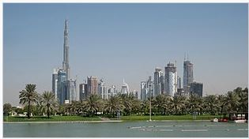
Investment in UAE
IBM Data Science Capstone Project

Slide 2
United Arab Emirates- a distant paradise from the western countries and Americas
Dubai is not only a distinctive and intriguing destination, but also a dynamic business center and a tourist paradise
more attractions, good food, shopping and quality accommodation.
The Glitzy city, Dubai is a land of monuments
BUT…..?

Slide 3
Questions to Answer
What are different cities in United Arab Emirates & what are the population
What are all the business areas those are popular there ?
Is the country too strict about business? No pubs, winery shops?
In different areas , which can be a good investment option?
How much populated the cities there? etc

Slide 4
Target Audience
Those who want to invest in UAE, but not aware of the place.

Slide 5
Data to Use
Wikipedia Link: https://en.wikipedia.org/wiki/List_of_cities_in_the_United_Arab_Emirates
Foresquare API , for Venue details

Slide 6
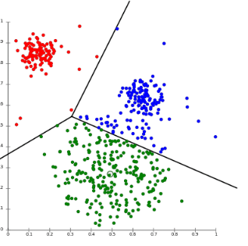
Data Cleansing and Clustering
Cleanbse the data , by removing unwanted columns & Rename those with special characters
Then we use K mean clustering

Slide 7
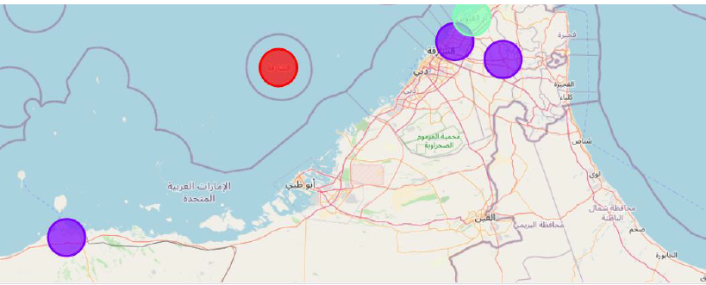
Visualisation
Clustered data plot in map:

Slide 8

Whats the biggest cluster
Well, its AJMAN,Rhuwais,Dhaid and the best visted shops are all food related

Slide 9

Whats of Less scope for invest?
Not much of Pubs/Bars

Slide 10
Results
1.Undoubtedly, Ajman is the best place to invest , as its well populated & people go out there often.
2.Food business is the best in Ajman.
3.Sharjah & Ummul Qaima are relax spots. Sharjah with sea side & other city with resorts. Those types of investments may be good here
4. Entire cities are nott too good for opening pubs/bars. Seems the culture is different from western countries.

Slide 11
Conclusion
Using the data from wikipedia and Python, and processing and analysing them using Python functions & clustering methods, we could find , Ajman is the best option to invest in Dubai & that too for food business. Also, it looks an investor friendly country with a beautiful geographical attractions. Hopefully, these findings may help someone to invest few of thie millions in Dubai in future !! :)

